Slide 1
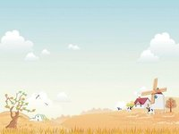
Unit 4 There are seven days in a week.
Book 4
Lesson 22
主讲教师：薛春梅
单 位：河工大附小
时 间：2018.5.8

Slide 2
Let’s chant!

Slide 3
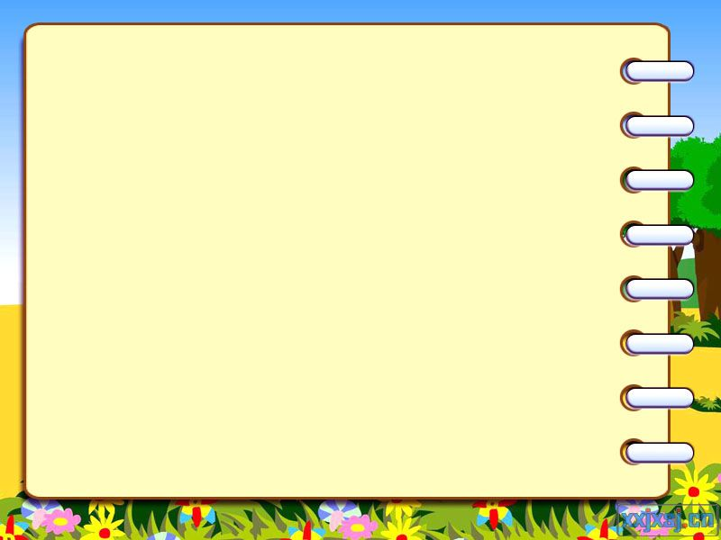
Let’s play a game. Give me a quick answer ,please.
How many days are there in a week?
What’s the first day of the week?
There are seven.
What day is today?
It’s Sunday.
It’s Tuesday.
Excellent

Slide 4
A new friend ,Linda will come to our class today.
Are you happy today?

Slide 5
Can you answer my questions?

Slide 6
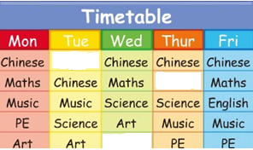
Q1.When do you have English?
Maths
English
English
We have English
on Wednesday,Thursday and Friday.

Slide 7
time
ride
Friday
ri

Slide 8
Let’s chant!
In a week, in a week.
There are seven days.
Friday, Friday.
Let’s go and play.

Slide 9
Let’s play a game!
F___ day
ir
ri
Friday,Friday,go!

Slide 10
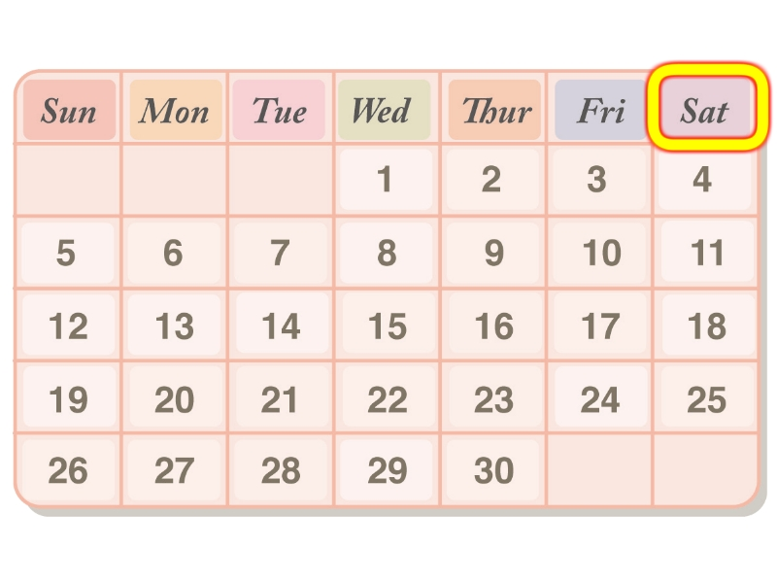
Q2.What’s the last day of the week?
cat
sat
Sat
surprise
ur
Saturday

Slide 11
Do you know?
Friday ： Friday在古英文中意思是Frigg‘s day。Frigg是北欧神话中的爱神。对于北欧人而言, 星期五是幸运的日子。然而对基督徒来说却是相反的, 因为耶稣受难日正好是星期五。 Saturday 星期六： Saturday在古英文中的意思是Saturn's day。Saturn是罗马神话中的农神, 掌管五谷, 就像中国神话中的神农大帝一样。

Slide 12
Let’s play a game!
Give me a quick answer,please.
Monday
Sunday
Wednesday
Tuesday
Friday
Thursday
Saturday

Slide 13
Let’s make a week.
Let’s sing a song!

Slide 14
Q3.What are they talking about?
Miss Green and her classmates are talking about. Let’s listen and watch.

Slide 16
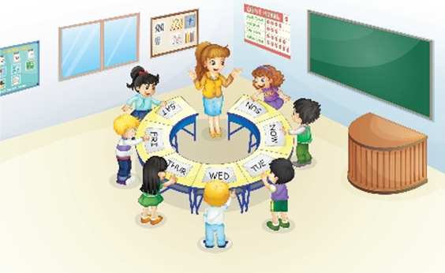

Slide 17
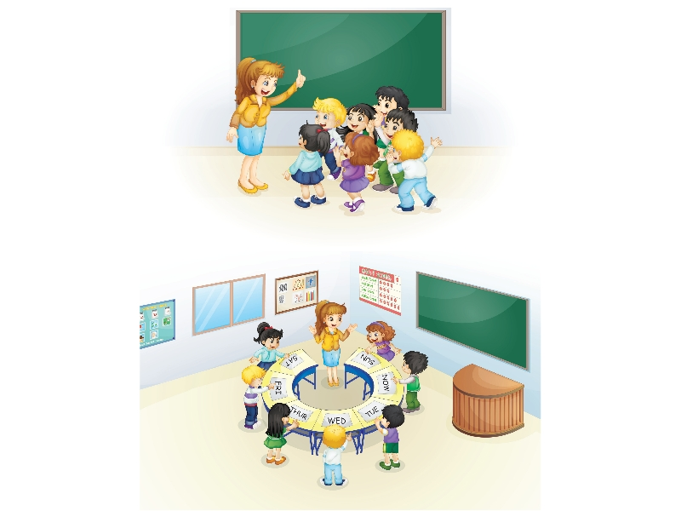

Slide 18
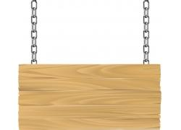
Reading time

Slide 19
Show time

Slide 20
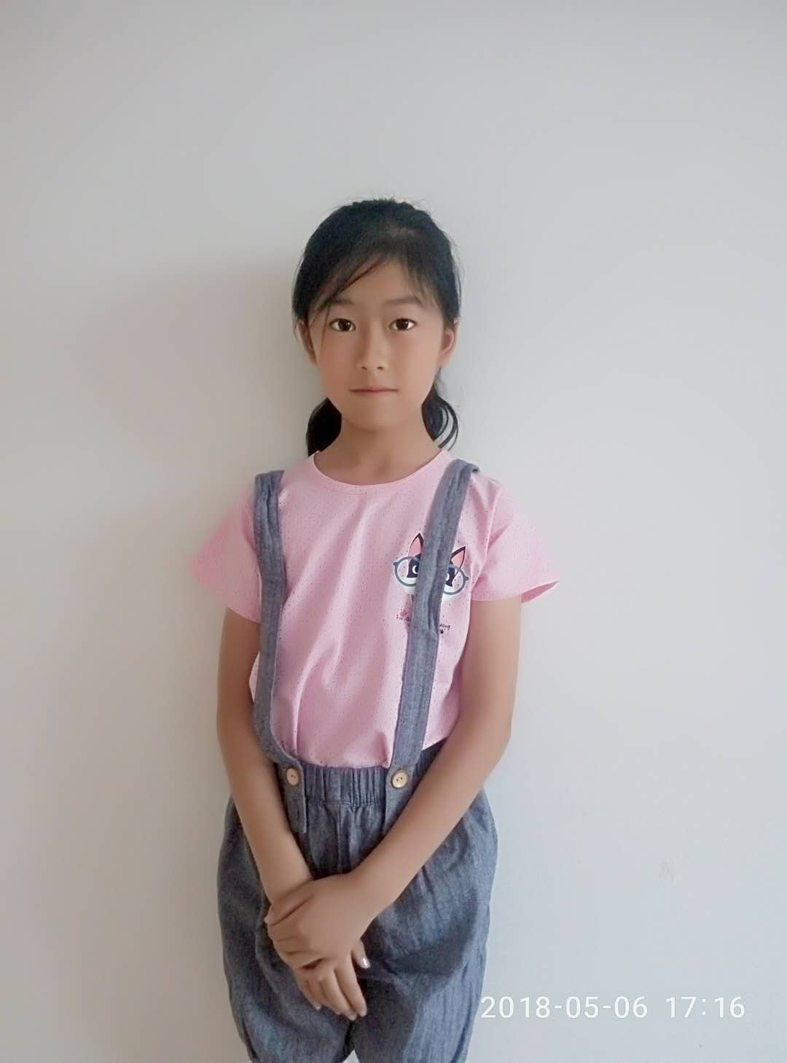
Today,we know Linda.
We know more,learn more.Everyday is new.
Let’s study hard,love everyday. We’ll be better in the future.

Slide 21
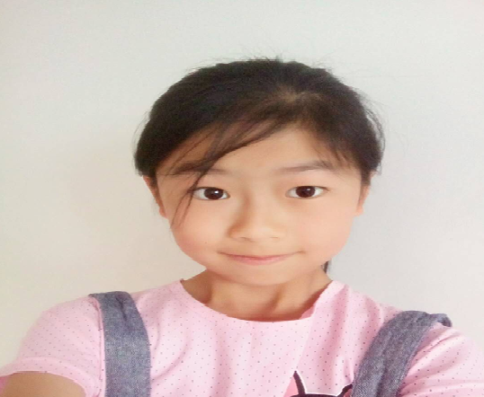
sending
Today,I’m very happy. You are my new friends. I know more,learn more. What about you? Please write to me.

Slide 22
Linda@126.com
My new friend@126.com
My study
Dear my new friend:
I’m very happy to be your new friend. Do you want to know about my study? OK,I will tell you. I go to school from Monday to Friday . I like English. I have English lessons on Wednesday, Thursday and Friday . I like singing. I have music lessons on Sunday. Today is Tuesday. Now I know the last day of the week is Saturday. What about you?
Best wishes,
Linda

Slide 23
Your new friend@126.com
Linda@126.com
My study
Dear Linda:
I’m very happy to be your new friend. Do you want to know about my study? OK,I will tell you. I go to school from _______ to _______ . I like English. I have English lessons on _______. I like _______. I have _______ lessons on _______. Today is _______. Now I know the last day of the week is _______. What about you?
Best wishes,
Linda

Slide 24
Homework
Listen and review the lesson 22.
2. Make a calendar(日历).

Slide 25
Thank you!

